Slide 1
Air Quality
Group:
Aufa Dhyia Aydan 1706043260
Muhamad Fadil 1706042812
Muhamad Farhan 1706042876

Slide 2
Outline
Introduction
Project management
Design and analyses
Implementation

Slide 3
Introduction

Slide 4
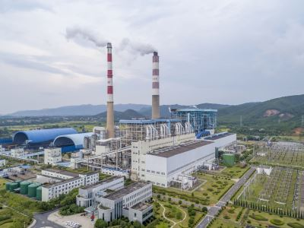
Air Quality
Air Quality is a tool used to determine the condition of the air around our environment. The device detects the level of CO2 around it so that the levels are monitored and displayed on the thinger.io or web page.

Slide 5
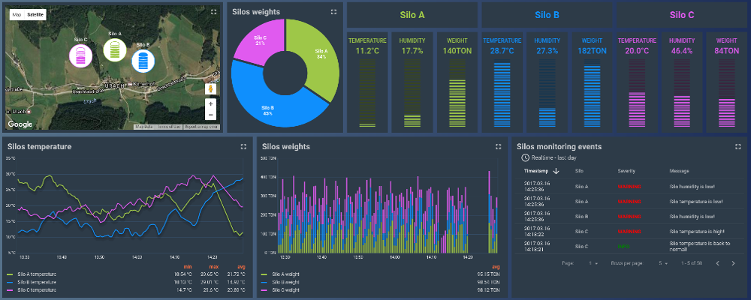
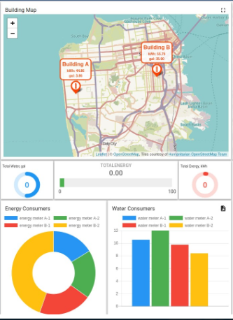
Air Quality
Place your screenshot here
https://thingsboard.io/

Slide 6
Project Managment

Slide 7
4 P
People:
• Developer: 3 members
• Supervisor: 1 Lecturer
Product
• Scope: FTUI Campus
• Objective: FTUI students
• Cost: 0% for using opensource (thingsboard)
• estimated time: 9 weeks
Process:
By using the Waterfall method.
• requairment: required software specifications (device, mobile apps, web)
• implementation: used to detect CO2 levels around the FTUI
• testing: implemented around FTUI whether it suits the needs (custemer is still a developer not yet a FTUI resident)
• maintenance: updating software according to existing needs or changing specifications so that the software can be optimized
Project:
• Projects must be accompanied by a project manager
• Projects that are made can be estimated when the completion will be on time. The group work we want is good student chemistry and regular inter-member discussions are held via social media (line) and with a meating system 2 or 3 times per week.

Slide 8
Features
a. Web thinger.io
b. Mobile apps
c. Data from device is stored at thinger.io
3. Tools:
a. MQ135 sensor
b. ESP 32
c. Thinger.io
d. Breadboard

Slide 9
Design And Analyses

Slide 10
Active UMl

Slide 11
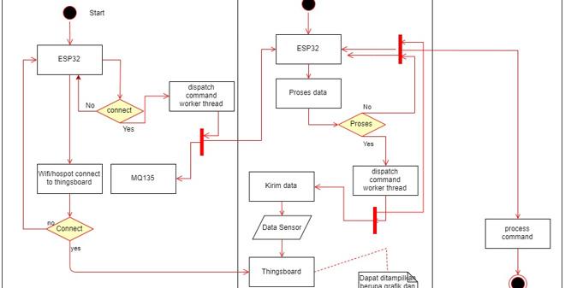

Slide 12
Sequence UML

Slide 13
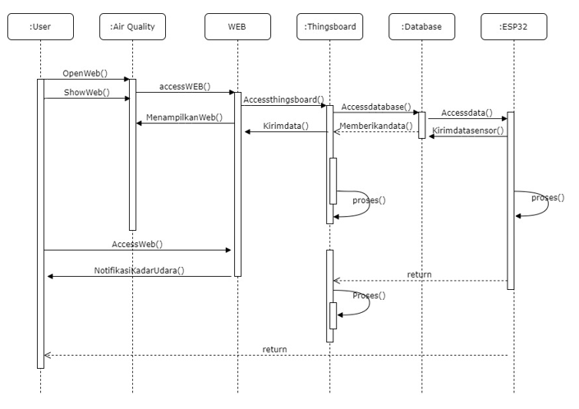

Slide 14
Class UML

Slide 15
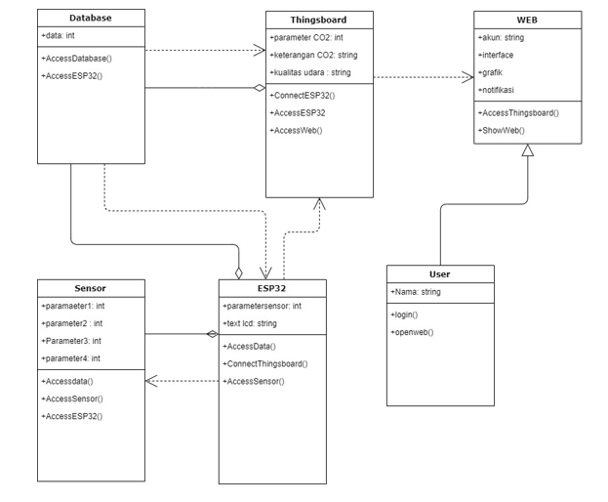

Slide 16
State UML

Slide 17
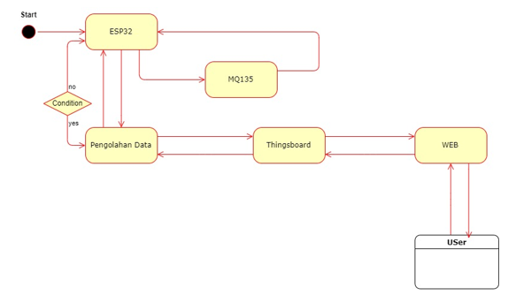

Slide 18
Project Planning Table

Slide 19
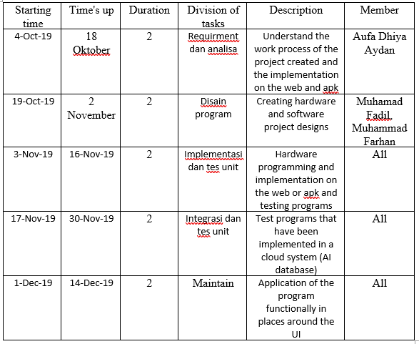

Slide 20


PLAN PROJECT
Project Plan is a project plan that uses
Programming Languages: PHP, HTML, CSS, Arduino
Repository: github
Framework: -
IDEA : -
Cloud: We use a database from Thingsboard that already provides an API

Slide 21

CNN METHODS
In the CNN method, we have just entered level 2, which is Repentable where there is a simple project management such as determining the cost and determining the work schedule that will be the starting point of success
Focus: Project Management

Slide 22
WATERFALL
We use the waterfall method in making this project because in this project we take a systematic approach and are carried out sequentially, so there are steps that are carried out sequentially (working on developing the model one by one), such as what should be done (planning), then how the modeling, construction, and how the system to its users.

Slide 23
Requirement Analysis
The Air Quality Application Program that we created is designed to determine the condition of the air around the FT environment by detecting CO2. Users only need to open the platform that we provide, then there will be a display of information about CO2 levels in every place that we install the air quality tool, in that platform we will also display information on whether the CO2 level has reached a good or bad stage in the environment.
• User page
A1. The user only sees the available page interface
• Admin page
B1. Admin can update CO2 levels
B2. Admin can update whether the CO2 condition is good enough or bad enough

Slide 24

Code & Support
Code : This Air Quality application project was designed using the Web (php, css, html), App (the application's own language), and Thingsboard (Arduino).
Support : All pc specifications are all biased

Slide 25

CASE TOOL
CASE TOOL> tools on computer devices that aim to support one or more software engineering activities in the software development process.
UPPER CASE> Case tools designed to support project planning, identification and selection. For the project, we use php, htlm, css for the web and the thingsboard platform
LOWER CASE> CASE tools designed to support the implementation and maintenance stages of SDLC. For the project we don't use the framework because we use thingsboard

